Slide 1


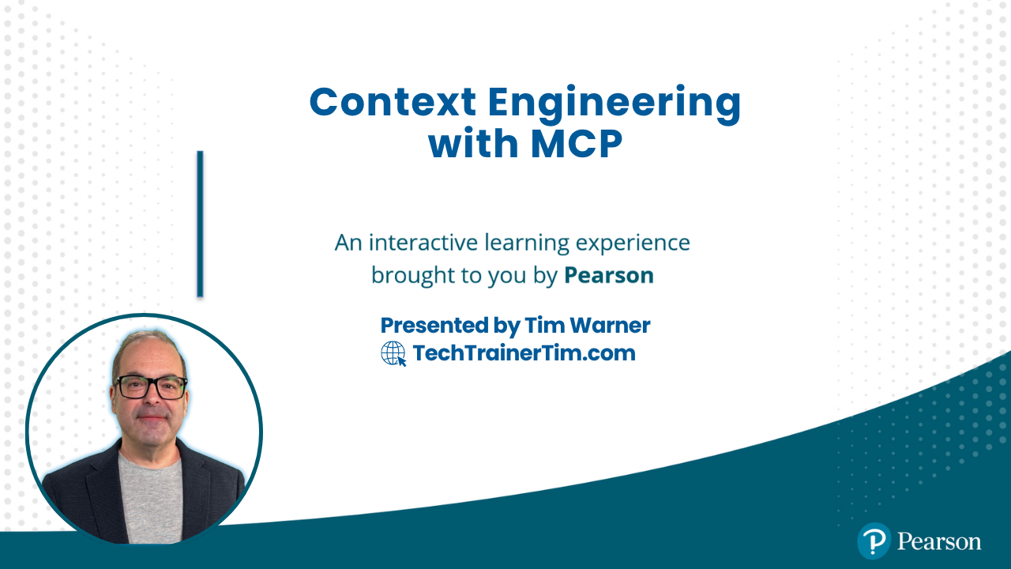
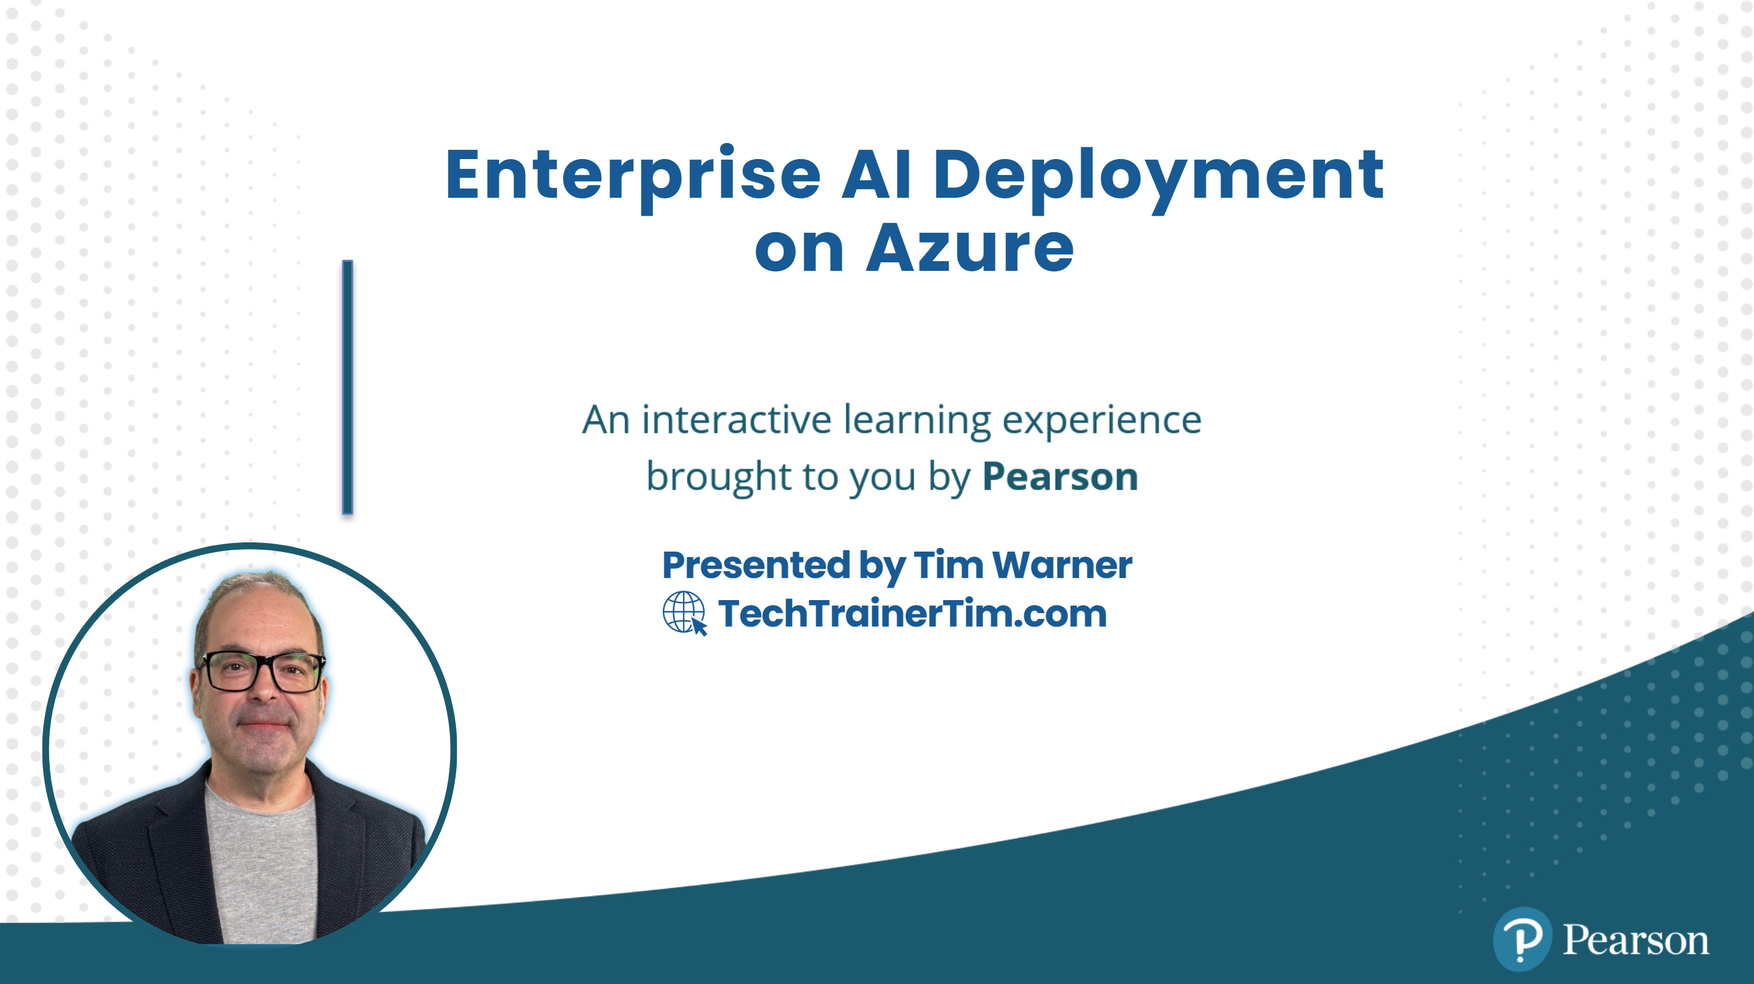




GitHub Copilot for Almost Everyone
Tim Warner
timw.info/linkedin
Notes:
How much flexibility am I allowed with these slide layouts? If you right-click a slide, you can play with layouts, but otherwise, not much flexibility.
Am I free to add my own graphics, providing MSFT attribution where necessary? When it comes to MS graphics, we're not allowed to use those, so please do not add in graphics unless they are created FROM SCRATCH by you.
Can I make the font a bit smaller? Some of the objectives are verbose and I don’t want to crowd the skills? Yes, I do this, too, when I review the slides because sometimes the default size just won't work.
Do the bullet points here need to be word-for-word from the outline or can I condense? We prefer word-for-word, but some of the sub-lesson titles are super long. Use your discretion, and we can address case-by-case during the review of each lesson's slides.

Slide 2
Context Engineering with MCP
Build AI Systems That Actually Remember
Tim Warner | Microsoft MVP | O'Reilly Live Training | January 2026

Slide 3
Tim Warner
• Based in Nashville, TN, US
• Microsoft tech specialist and trainer since 1997 (Windows NT 4.0)
• Microsoft Certified Trainer (MCT)
• Microsoft MVP in Azure AI & Cloud/Datacenter Management
• 200+ courses on Pluralsight, 1M+ learners
• Contact: techtrainertim.com

Slide 4
Course Flow (4 Segments × 50 min)
• Segment 1: All About Context — Token economics, memory types, why AI forgets
• Segment 2: All About MCP — Protocol deep-dive with FastMCP, tools, resources
• Segment 3: Semantic Memory Stores — JSON → SQLite/NetworkX → ChromaDB → Azure AI Search
• Segment 4: Production Clients — Claude Desktop, VS Code, Copilot, LangGraph
• 10-minute breaks between segments
• Hands-on labs throughout

Slide 5
Course materials
timw.info/context

Slide 6
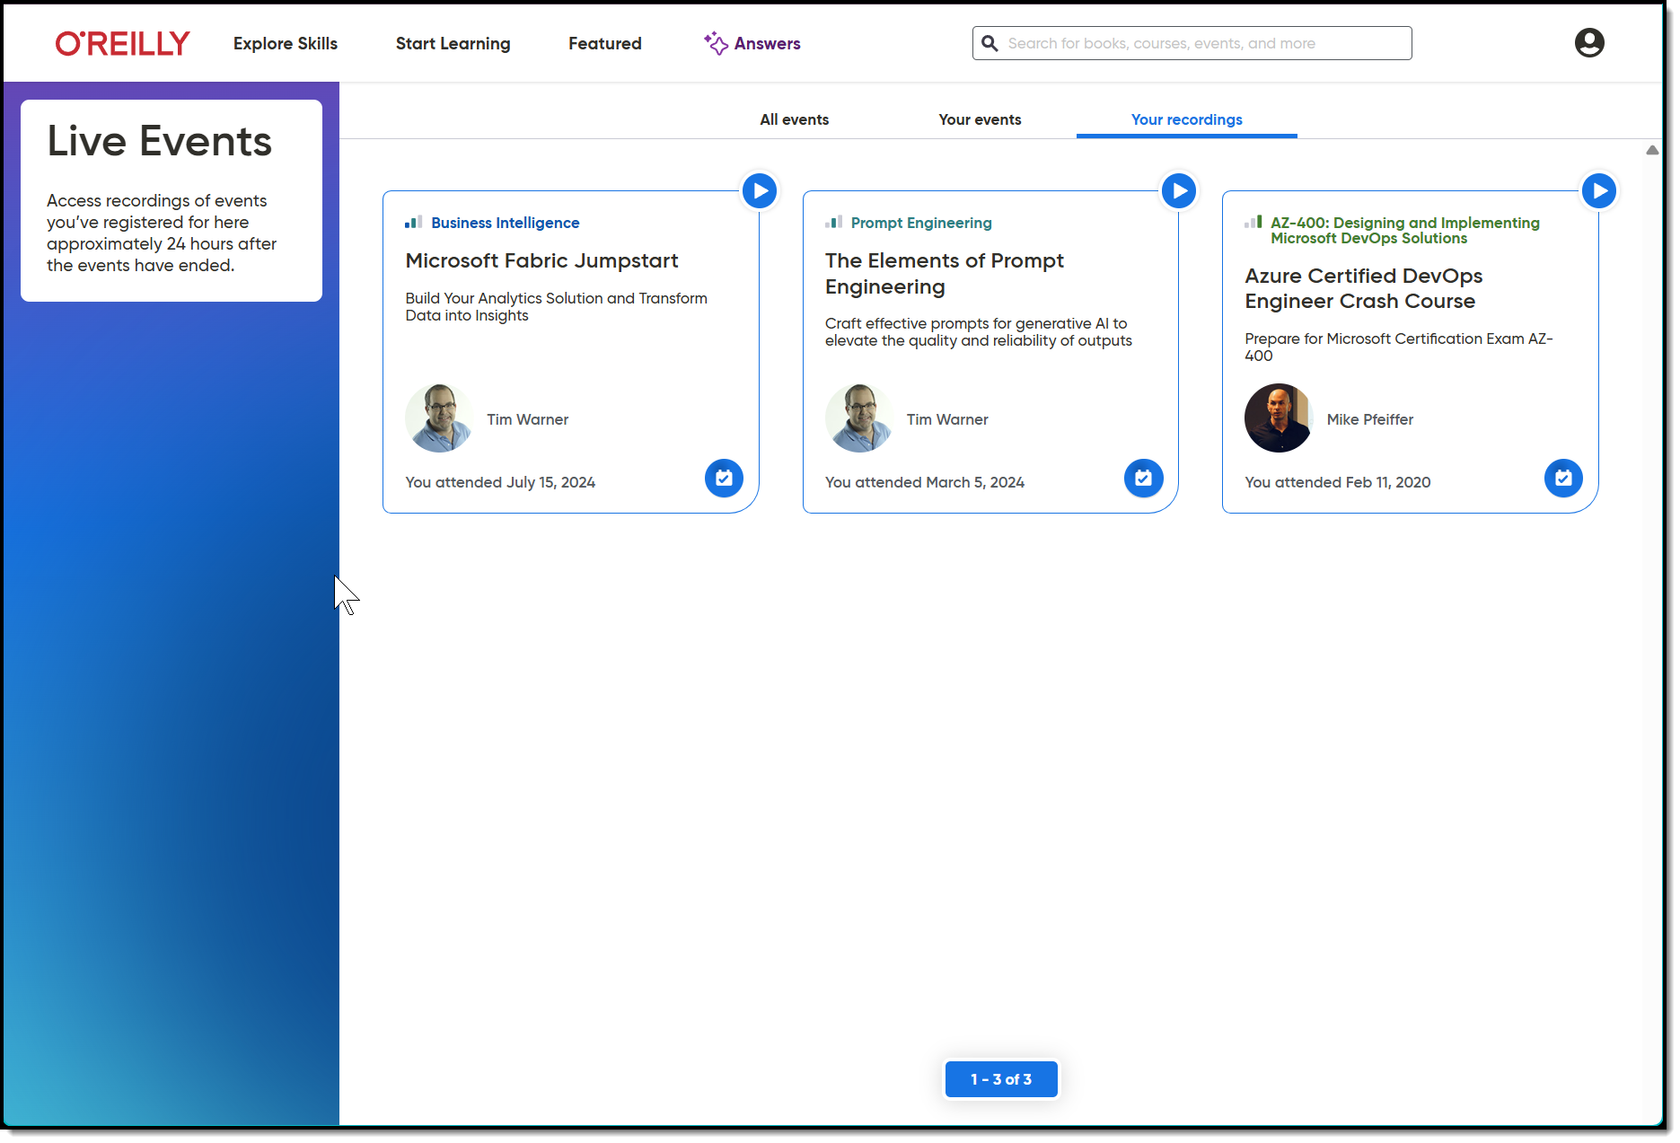
Session Recording + Badge

Slide 7
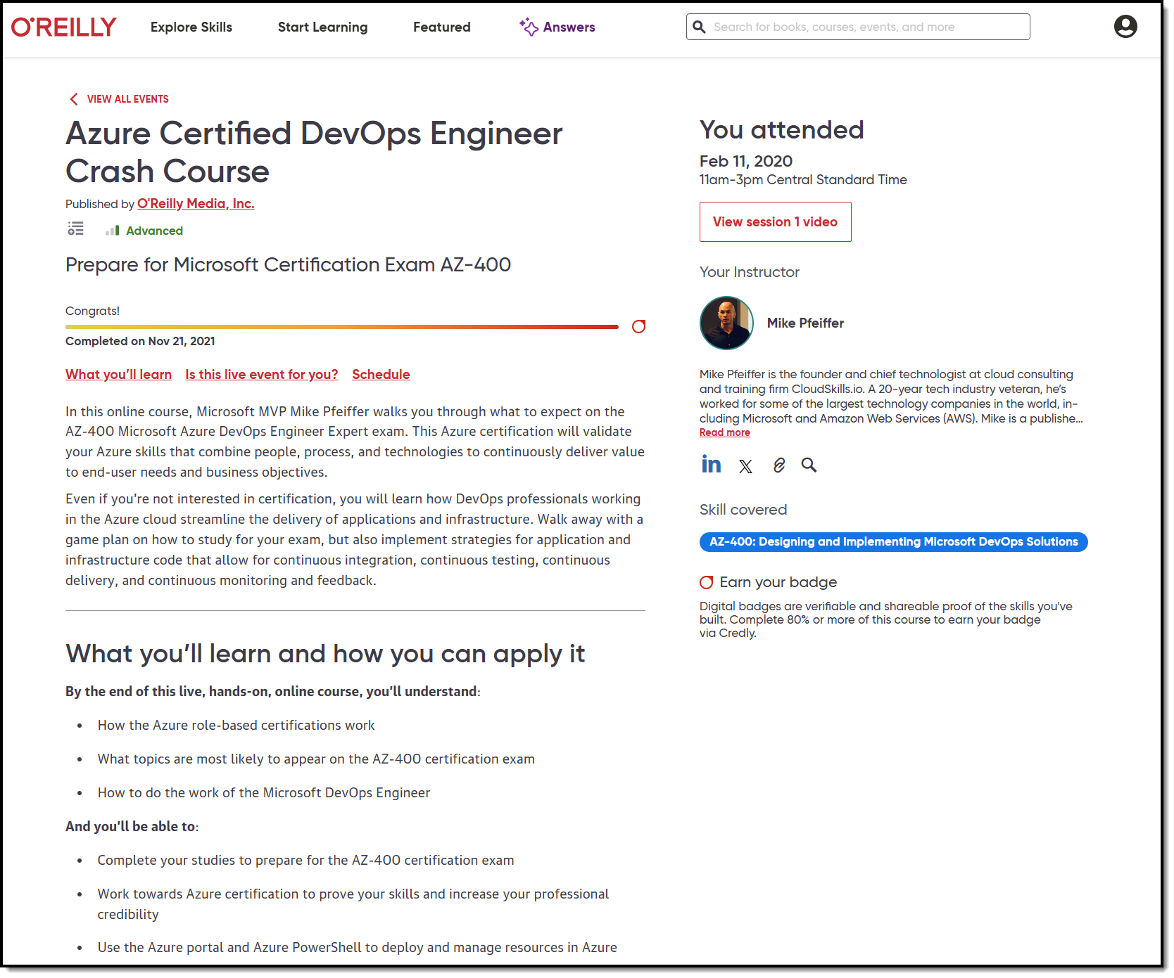
Session Recording + Badge

Slide 8
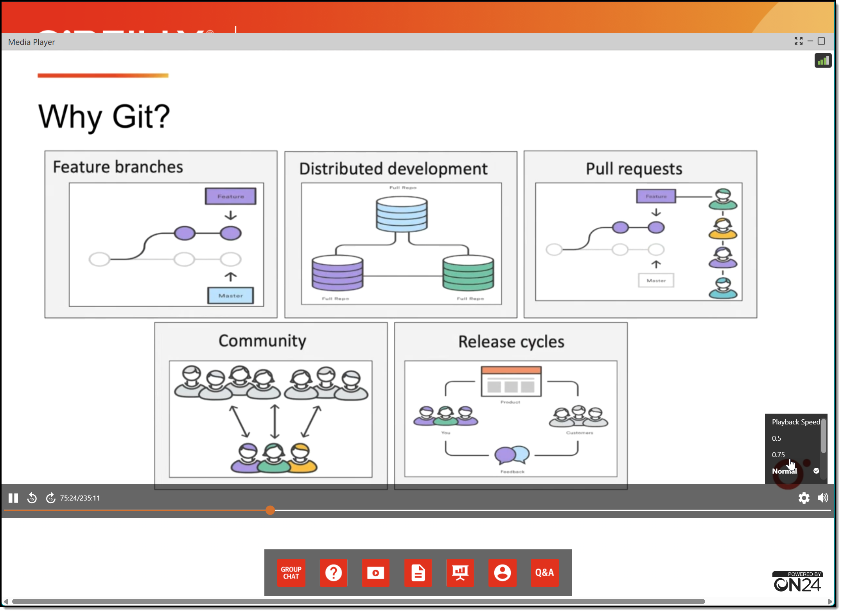
Session Recording + Badge

Slide 9
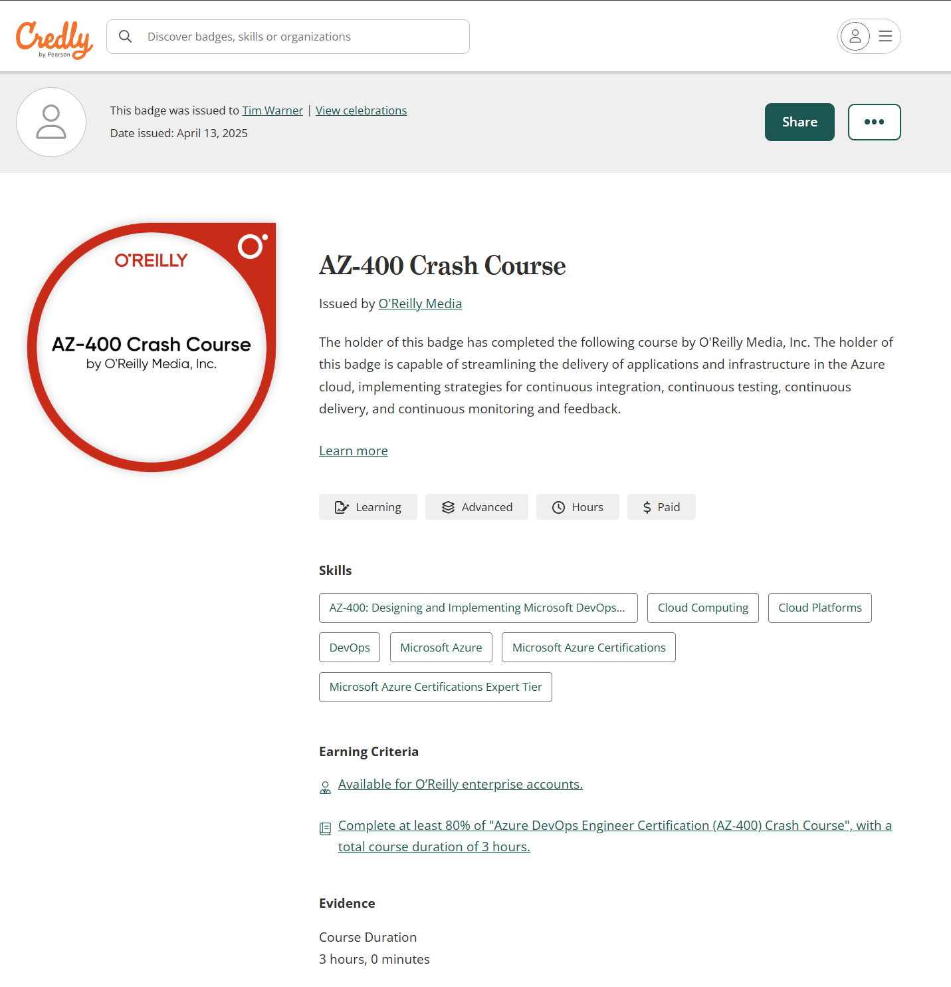
Session Recording + Badge

Slide 10
"The difference between a helpful AI assistant and a transformative AI partner is memory. Without persistent context, every conversation starts from zero."
— The Context Engineering Manifesto

Slide 11
SEGMENT 01
All About Context
Why Your AI Has Amnesia — And How to Fix It

Slide 12
What is a Context Window?
• The AI's 'working memory' — everything visible during generation
• Measured in tokens (~0.75 words, ~4 characters per token)
• Includes: System prompt + conversation history + tools + output buffer
• When full, oldest content gets pushed out (FIFO amnesia)
• The fundamental constraint that shapes all AI system design
Notes:
Start with the basics. Most learners underestimate how constrained context really is.

Slide 13
Context Windows in 2026
• Claude Sonnet/Opus: 200K tokens ($3-15/M input)
• GPT-4o: 128K tokens ($2.50/M input)
• Gemini 2.0: 2M tokens ($0.075/M input)
• Llama 4: 10M tokens (coming soon)
• Bigger isn't always better — quality degrades with length

Slide 14
The Context Budget Formula
# What you THINK you have: max_tokens = 200_000 # Claude Sonnet 4 # What you ACTUALLY have: system_prompt = 5_000 # Instructions, rules output_buffer = 8_000 # Response generation safety_margin = 10_000 # Avoid edge cases tool_definitions = 15_000 # MCP servers add up! conversation_hist = 50_000 # Previous turns available = 200K - 5K - 8K - 10K - 15K - 50K # = 112,000 tokens for YOUR content

Slide 15
The Four Types of Context Loss
Window Overflow
Session Boundary
Oldest messages pushed out as new ones arrive. Happens in long conversations. → Solution: Selective retention + importance scoring
Complete reset between sessions. User returns next day — AI remembers nothing. → Solution: Persistent memory stores
Attention Dilution
Compression Loss
Context exists but gets 'lost in the noise'. Model focuses on wrong parts. → Solution: Strategic context organization
Summarization loses critical details. Trade-off between length and fidelity. → Solution: Hierarchical memory + smart retrieval

Slide 16
The 'Lost in the Middle' Problem
• LLMs weigh beginning and end of context more heavily (primacy + recency bias)
• Critical information in the middle gets undervalued — even if it fits!
• Studies show performance drops 15-30% for middle-positioned facts
• Solution: Put important context at START or END of your prompts
• Better solution: Use memory systems to surface relevant context dynamically

Slide 17
Why RAG Isn't Enough
RAG Limitations
What We Actually Need
• One-shot retrieval (no iteration)
• No write-back capability
• Static chunk boundaries
• No learning from interactions
• Retrieval ≠ Memory
• Working Memory (current session)
• Episodic Memory (past conversations)
• Semantic Memory (knowledge base)
• Procedural Memory (learned patterns)
• Memory ≠ Retrieval

Slide 18
The Four Memory Types in AI Systems
WORKING MEMORY
EPISODIC MEMORY
'What am I doing right now?' Context window, in-memory cache. Current task state, active prompts.
'What happened last time?' Conversation history, session summaries. Stored with timestamps and threads.
SEMANTIC MEMORY
PROCEDURAL MEMORY
'What do I know as facts?' Knowledge bases, vector stores. Facts learned from interactions.
'How do I do things?' System prompts, tool sequences. Learned behavioral patterns.

Slide 19
"Context Engineering is the systematic design of what information an AI can access, remember, and utilize across interactions. It's Capture → Store → Retrieve — done right."
— Our Working Definition

Slide 20
The Three Pillars of Context Engineering
CAPTURE
STORE
RETRIEVE
Decide WHAT to preserve
Decide WHERE and HOW
Decide WHEN and WHAT
Importance scoring, entity extraction, decision tracking
JSON → SQLite → Vectors → Cloud (choose your adventure)
Semantic search, recency, relevance ranking

Slide 21
SEGMENT 02
All About MCP
The Universal Protocol for AI Context

Slide 22
Model Context Protocol (MCP)
• Open standard created by Anthropic, adopted by OpenAI & Google (Dec 2025)
• Now under the Linux Foundation's Agentic AI Foundation (AAIF)
• JSON-RPC 2.0 based protocol for AI ↔ tool communication
• Three primitives: Tools (actions), Resources (data), Prompts (templates)
• One protocol, every client — Claude, Copilot, VS Code, custom agents
• The USB-C of AI integrations

Slide 23
MCP's Three Primitives
TOOLS
store_memory(), search(), execute()
Model-controlled functions the AI can invoke
RESOURCES
memory://stats, file://config.json
Application-controlled data the AI can read
PROMPTS
/summarize, /remember, /context
User-controlled templates for common workflows

Slide 24
MCP Transport Mechanisms
Local (stdio)
Remote (HTTP+SSE)
• Process spawned by client
• Communication via stdin/stdout
• Zero network latency
• Excellent security (sandboxed)
• Best for: dev tools, local memory
• Server running anywhere
• SSE for server → client streaming
• POST for client → server calls
• Requires TLS in production
• Best for: shared memory, teams

Slide 25
FastMCP: Python-First MCP Development
• The Flask/FastAPI of MCP development
• Pythonic decorators for tools, resources, prompts
• Built-in Pydantic validation with automatic schema generation
• Development server with hot reload included
• Type hints become JSON Schema automatically
• From idea to working MCP server in 5 minutes

Slide 26
Your First FastMCP Server
from fastmcp import FastMCP from pydantic import BaseModel, Field mcp = FastMCP("memory-server") class MemoryInput(BaseModel): content: str = Field(..., description="Content to remember") importance: int = Field(default=5, ge=1, le=10) @mcp.tool() async def store_memory(params: MemoryInput) -> str: """Store information for later retrieval.""" memory_id = save_to_store(params.content, params.importance) return f"Stored as {memory_id}" @mcp.resource("memory://stats") async def get_stats() -> str: """Memory system statistics.""" return json.dumps({"total": count_memories()}) if __name__ == "__main__": mcp.run() # That's it!

Slide 27
MCP Tool Annotations (2025 Spec)
@mcp.tool( name="store_memory", annotations={ "title": "Store Memory", # Human-readable name "readOnlyHint": False, # Modifies state "destructiveHint": False, # Not dangerous "idempotentHint": False, # Not safe to retry "openWorldHint": True, # Accesses external systems } ) async def store_memory(params: MemoryInput) -> str: """Store information for future retrieval. Use this tool to save important facts, user preferences, decisions, or any content that should persist across sessions. """ # Implementation...

Slide 28
Testing with MCP Inspector
• Essential for development — don't skip this!
• Visual tool for exploring and debugging MCP servers
• Launch: npx @anthropic/mcp-inspector python server.py
• See all tools, resources, prompts with their schemas
• Test tool calls interactively with live results
• Inspect raw JSON-RPC messages for debugging

Slide 29
Hello World with Node.js
// server.js import { Server } from "@modelcontextprotocol/sdk/server/index.js"; import { StdioServerTransport } from "@modelcontextprotocol/sdk/server/stdio.js"; const server = new Server( { name: "hello-mcp", version: "1.0.0" }, { capabilities: { tools: {}, resources: {} } } ); server.setRequestHandler("tools/list", async () => ({ tools: [{ name: "echo", description: "Echoes back your message", inputSchema: { type: "object", properties: { message: { type: "string" } }, required: ["message"] } }] })); server.setRequestHandler("tools/call", async (req) => ({ content: [{ type: "text", text: \`Echo: \${req.params.arguments.message}\` }] })); const transport = new StdioServerTransport(); await server.connect(transport);

Slide 30
SEGMENT 03
Semantic Memory Stores
From Prototype to Production-Scale Memory

Slide 31
The Memory Storage Spectrum
Start simple, scale when needed
JSON File
SQLite + NetworkX
ChromaDB
Azure AI Search
Zero dependencies, instant setup Perfect for <1000 memories
Structured queries + graph algos Knowledge Graph with triplet store
Vector embeddings, semantic search Best for dev/test with similarity
Enterprise vectors, managed infra Production scale with full text + semantic
Simple ←───────────────────────────────────────────────────────→ Powerful

Slide 32
JSON Memory Store
# app/adapters/json_store.py — Schematica's simplest backend class RawJsonStore(MemoryStore): """Memory store backed by raw JSON files. Semantic search falls back to keyword matching.""" def __init__(self, json_path: Optional[Path] = None): self.json_path = json_path or settings.json_path self._schematics: Dict[str, Schematic] = {} self._hits: deque[RetrievalHit] = deque(maxlen=100) self._load_schematics() def _keyword_score(self, schematic: Schematic, query: str) -> float: """Simple keyword-based relevance score.""" query_lower = query.lower() text = schematic.to_embed_text().lower() matches = sum(1 for word in query_lower.split() if word in text) phrase_bonus = 0.2 if query_lower in text else 0.0 return min(1.0, matches / max(len(query_lower.split()), 1) + phrase_bonus) async def semantic_search(self, query: str, filters: dict = None, top_k: int = 5) -> List[SearchResult]: scored = [(s, self._keyword_score(s, query)) for s in self._schematics.values()] scored = [(s, score) for s, score in scored if score > 0] scored.sort(key=lambda x: x[1], reverse=True) return [SearchResult(schematic=s, score=score) for s, score in scored[:top_k]]

Slide 33
SQLite + NetworkX Knowledge Graph
# app/adapters/graph_store.py — Schematica's Knowledge Graph class GraphStore: """SQLite-backed triplet store with NetworkX for graph algorithms.""" def __init__(self, db_path: Path = None): self.db_path = db_path or Path("data/graph/knowledge.db") self._local = threading.local() # Thread-safe connections self._graph: nx.DiGraph = nx.DiGraph() self._init_db() self._load_graph() # Sync SQLite -> NetworkX on startup async def add_relationship(self, rel: Relationship) -> bool: """Add triplet to SQLite + NetworkX in one operation.""" with self._get_connection() as conn: conn.execute("""INSERT OR IGNORE INTO triplets (subject, predicate, object) VALUES (?, ?, ?)""", (rel.subject, rel.predicate, rel.object)) self._graph.add_edge(rel.subject, rel.object, predicate=rel.predicate) return True async def get_neighbors(self, entity_id: str, direction="both") -> list: """1-hop traversal using NetworkX's fast graph ops.""" neighbors = set() if direction in ("outgoing", "both"): neighbors.update(self._graph.successors(entity_id)) if direction in ("incoming", "both"): neighbors.update(self._graph.predecessors(entity_id)) return list(neighbors) async def shortest_path(self, source: str, target: str) -> list: return nx.shortest_path(self._graph.to_undirected(), source, target)

Slide 34
Why Vector Search Matters
• Traditional search: 'find python' → exact keyword match
• Vector search: 'find programming tips' → returns Python, JS, coding best practices
• Embeddings convert text to high-dimensional vectors (768-3072 dimensions)
• Similar meanings cluster together in vector space
• Cosine similarity finds semantically related content, not just keywords
• The leap from matching to understanding

Slide 35
ChromaDB Semantic Memory
# app/adapters/chroma_store.py — Schematica's vector layer class ChromaMemoryStore(MemoryStore): """Chroma vectors with JSON as source of truth.""" def __init__(self, chroma_path: Path = None, json_path: Path = None): self.chroma_path = chroma_path or settings.chroma_path self.json_store = RawJsonStore(json_path) # JSON = source of truth self._collection = None self._initialized = False async def _ensure_initialized(self) -> None: if self._initialized: return self._client = chromadb.PersistentClient(path=str(self.chroma_path)) self._collection = self._client.get_or_create_collection( name="warnerco_schematics", metadata={"description": "WARNERCO robot schematics embeddings"}, ) self._initialized = True async def semantic_search(self, query: str, filters: dict = None, top_k: int = 5) -> List[SearchResult]: await self._ensure_initialized() results = self._collection.query( query_texts=[query], n_results=top_k, include=["documents", "metadatas", "distances"], ) # Convert L2 distance to similarity score return [SearchResult(schematic=await self.json_store.get_schematic(id), score=max(0.0, 1.0 - (dist / 2.0))) for id, dist in zip(results["ids"][0], results["distances"][0])]

Slide 36
Azure AI Search: Enterprise-Scale Memory
# app/adapters/azure_search_store.py — Schematica production backend class AzureAiSearchMemoryStore(MemoryStore): """Azure AI Search with local JSON as source of truth.""" async def _ensure_initialized(self) -> None: from azure.core.credentials import AzureKeyCredential from azure.search.documents import SearchClient from azure.search.documents.indexes import SearchIndexClient credential = AzureKeyCredential(settings.azure_search_key) self._index_client = SearchIndexClient( endpoint=settings.azure_search_endpoint, credential=credential) await self._ensure_index() # Auto-create schema from Pydantic model! self._client = SearchClient( endpoint=settings.azure_search_endpoint, index_name=settings.azure_search_index, credential=credential) async def semantic_search(self, query: str, filters: dict = None, top_k: int = 5) -> List[SearchResult]: # Build OData filter from dict filter_expr = self._build_filter(filters) if filters else None results = self._client.search( search_text=query, filter=filter_expr, top=top_k, include_total_count=True) return [SearchResult( schematic=await self.json_store.get_schematic(r["id"]), score=r["@search.score"]) for r in results]

Slide 37
Unified Memory Interface
# app/adapters/factory.py — Thread-safe singleton pattern from app.config import MemoryBackend, settings _memory_store: Optional[MemoryStore] = None _memory_store_lock = threading.Lock() def get_memory_store() -> MemoryStore: """Factory with double-checked locking.""" global _memory_store if _memory_store is not None: return _memory_store with _memory_store_lock: if _memory_store is not None: return _memory_store if settings.memory_backend == MemoryBackend.JSON: from app.adapters.json_store import RawJsonStore _memory_store = RawJsonStore() elif settings.memory_backend == MemoryBackend.CHROMA: from app.adapters.chroma_store import ChromaMemoryStore _memory_store = ChromaMemoryStore() elif settings.memory_backend == MemoryBackend.AZURE_SEARCH: from app.adapters.azure_search_store import AzureAiSearchMemoryStore _memory_store = AzureAiSearchMemoryStore() return _memory_store

Slide 38
Scratchpad Memory: Session Working Memory
# app/adapters/scratchpad_store.py — LLM-minimized working memory class ScratchpadStore: """In-memory triplet store with LLM minimization & enrichment.""" def __init__(self, max_tokens: int = 5000, entry_ttl_minutes: int = 60): self._entries: Dict[str, ScratchpadEntry] = {} self._lock = threading.RLock() self._encoding = tiktoken.get_encoding("cl100k_base") # Token counting async def write(self, subject: str, predicate: str, object_: str, content: str, minimize: bool = True) -> ScratchpadWriteResult: """Store observation with optional LLM minimization.""" if minimize: minimized, orig_tokens, min_tokens = await self._minimize_content(content) self._enforce_token_budget(min_tokens) # Evict oldest if needed entry = ScratchpadEntry(id=self._generate_id(), subject=subject, predicate=predicate, object_=object_, content=minimized, original_tokens=orig_tokens, minimized_tokens=min_tokens) self._entries[entry.id] = entry return ScratchpadWriteResult(entry=entry, tokens_saved=orig_tokens - min_tokens) def get_context_for_injection(self, token_budget: int = 1500) -> Tuple[List[str], int]: """Format entries for LangGraph injection within budget.""" return [f"[{e.predicate}] {e.subject} -> {e.object_}: {e.content}" for e in sorted(self._entries.values(), key=lambda e: e.created_at, reverse=True)], total

Slide 39
SEGMENT 04
MCP in Production
Claude Desktop, VS Code, Copilot & Beyond

Slide 40
MCP Client Landscape (2026)
• Claude Desktop — Anthropic's flagship app with full MCP support
• Claude Code — Terminal-based coding agent with project-scoped MCP
• VS Code — MCP extension + GitHub Copilot integration
• Cursor, Windsurf — AI-first IDEs with MCP support
• Custom agents — LangChain, LangGraph, Semantic Kernel, your own!
• One protocol, endless possibilities

Slide 41
Claude Desktop Configuration
~/Library/Application Support/Claude/claude_desktop_config.json
{ "mcpServers": { "memory": { "command": "python", "args": ["-m", "memory_server"], "env": { "MEMORY_BACKEND": "sqlite", "MEMORY_PATH": "~/Documents/claude_memories.db" } }, "filesystem": { "command": "npx", "args": ["-y", "@modelcontextprotocol/server-filesystem", "~/Projects"] }, "github": { "command": "npx", "args": ["-y", "@modelcontextprotocol/server-github"], "env": { "GITHUB_TOKEN": "${GITHUB_TOKEN}" } } } }

Slide 42
Claude Code: Project-Scoped Memory
// .claude/mcp.json in your project root { "mcpServers": { "project-memory": { "command": "python", "args": ["./tools/memory_server.py"], "cwd": "${workspaceFolder}", "env": { "MEMORY_PATH": ".claude/memories.json" } } } } // Usage in Claude Code: // > Remember that we decided to use FastAPI for the backend // [Claude stores this decision in project memory] // // > What framework did we choose? // [Claude retrieves: "FastAPI for the backend"] // // Memory persists across sessions and can be git-committed!

Slide 43
VS Code + GitHub Copilot
// .vscode/settings.json { "mcp.servers": { "workspace-memory": { "command": "python", "args": ["${workspaceFolder}/tools/memory_server.py"] } }, "github.copilot.chat.experimental.mcpServers": true } // In Copilot Chat: // @workspace What API patterns have we established? // → Copilot queries MCP memory for project context // @workspace /remember We're using Repository pattern // → Stores decision in memory for future reference // MCP tools appear in Copilot's tool picker // Memory persists across VS Code sessions

Slide 44
LangGraph 7-Node RAG Pipeline
• parse_intent → query_graph → inject_scratchpad → retrieve
• → compress_context → reason → respond
• Knowledge Graph enriches context with relationship data
• Scratchpad provides session-scoped working memory
• Intent classification: LOOKUP, DIAGNOSTIC, ANALYTICS, SEARCH
• Azure OpenAI for reasoning, fallback stub if unavailable

Slide 45
LangGraph with Knowledge Graph + Scratchpad
# app/langgraph/flow.py - 7-node RAG pipeline class SchematicaGraph: async def _build_graph(self): from langgraph.graph import StateGraph, END workflow = StateGraph(GraphState) # Add 7 nodes workflow.add_node("parse_intent", parse_intent) workflow.add_node("query_graph", query_graph) # NetworkX workflow.add_node("inject_scratchpad", inject_scratchpad) workflow.add_node("retrieve", retrieve) # Vector search workflow.add_node("compress_context", compress_context) workflow.add_node("reason", reason) # Azure OpenAI workflow.add_node("respond", respond) workflow.set_entry_point("parse_intent") workflow.add_edge("parse_intent", "query_graph") workflow.add_edge("query_graph", "inject_scratchpad") # ... full pipeline workflow.add_edge("respond", END) self._graph = workflow.compile()

Slide 46
Production Security
from fastapi import FastAPI, Depends, HTTPException from fastapi.security import HTTPBearer app = FastAPI() security = HTTPBearer() async def verify_token(credentials = Depends(security)): """Verify API key or JWT token.""" # In prod: validate against Azure AD, Auth0, etc. if credentials.credentials not in VALID_TOKENS: raise HTTPException(status_code=401) return credentials @app.post("/mcp/message", dependencies=[Depends(verify_token)]) async def handle_mcp(request: dict): return await mcp.handle_request(request) # Also consider: # - Rate limiting per user # - Audit logging for compliance # - Encryption at rest for memories # - Namespace isolation for multi-tenant

Slide 47
Production Deployment Patterns
Local (stdio)
Remote (HTTP+SSE)
• Run as subprocess
• No network exposure
• Per-user isolation
• Best for: desktop apps
• Zero infrastructure
• Containerized deployment
• Shared team memory
• Authentication required
• Best for: teams, enterprise
• Azure Container Apps, Railway

Slide 48
Key Takeaways
• 1. Context is finite and expensive — every token costs money and attention
• 2. MCP standardizes AI ↔ tool communication across all major clients
• 3. Start with JSON, graduate to SQLite, scale with vectors when needed
• 4. Memory transforms AI from assistant to partner — deploy it everywhere
• 5. The three pillars: Capture → Store → Retrieve — done right

Slide 49
Resources & Next Steps
Official Documentation
Course Materials
• modelcontextprotocol.io — MCP spec
• docs.anthropic.com — Claude docs
• github.com/jlowin/fastmcp — FastMCP
• docs.trychroma.com — ChromaDB
• learn.microsoft.com/azure/search — Azure AI Search
• github.com/timothywarner-org/context-engineering
• WARNERCO Schematica — full working example
• LangGraph 7-node RAG pipeline
• Azure deployment templates
• techtrainertim.com

Slide 50
Thank You!
Now go build AI systems that actually remember!
Tim Warner | techtrainertim.com

